Slide 1
AERODYNAMICS
د. محمد خضير عباس

Slide 2
Contents
Aerodynamics: Some Introductory Thoughts
Aerodynamics: Some Fundamental Principles and Equations
Fundamentals of Inviscid, Incompressible Flow
Incompressible Flows Over Airfoils
Incompressible Flows Over Finite Wings

Slide 3
Chap.1
Aerodynamics: Some Introductory Thoughts

Slide 4
OUTLINE
Classification and practical objectives
Some fundamental aerodynamic variables
Aerodynamic forces and moments
Center of pressure
Dimensional analysis
Flow similarity
Types of flow

Slide 5
Classification and practical objectives
Distinction between Solid and Fluid
Under application of shear force
Solid: finite deformation
Fluid: continuously increasing deformation
Classification of fluid dynamics
Hydrodynamics: flow of liquids
Gas dynamics: flow of gases
Aerodynamics: flow of air

Slide 6
Practical objectives of aerodynamics
The prediction of forces and moments on, and heat transfer to, bodies moving through a fluid (usually air).
Determination of flows moving internally through ducts. (ex. Flow properties inside rocket and air-breathing jet engines)

Slide 7
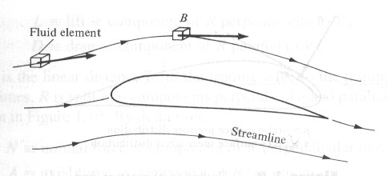
Some fundamental aerodynamic variables
Pressure:
Density:
Temperature, T
Flow velocity, V

Slide 8
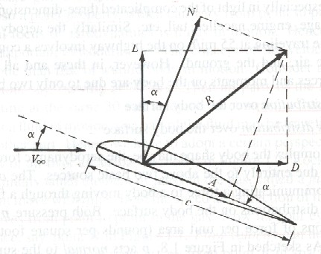
Aerodynamic forces and moments
Aerodynamic forces and moments are due to
Pressure distribution
Shear stress distribution
Nomenclature
R ≡ resultant force
L ≡ lift
D ≡ drag
N ≡ normal force
A ≡ Axial force

Slide 9
Relation between L,D and N,A
Representation of N´, A´and M´LE in terms of pressure p and shear stress τ
Primes denote force per unit span
Subscript ‘u’ denote upper surface while ‘l’ denote lower surface

Slide 11
Dimensionless force and moment coefficient
S = reference area ( planform area for wing)
l = reference length (chord length for wing)
Dynamic pressure
Lift coefficient
Drag coefficient
Normal force coefficient
Axial force coefficient
Moment coefficient

Slide 12
Center of pressure
Definition
The point on the body about which the aerodynamic moment is zero.
Location of center of pressure
, if α is small ⇒

Slide 13
Dimensional analysis
Factors affecting aerodynamic force R
Free stream velocity V∞
Free stream density ρ∞
Viscosity of the fluid μ∞
The size of the body (usually represented by the chord length c)
The compressibility of the fluid a∞
R=f(ρ∞, V∞, c, μ∞, a∞). Dimensional analysis can reduce the number of independent parameters affecting R, such that can save the cost of wind tunnel test.

Slide 14
Buckingham pi theorem
Fundamental dimensions :
m = dimension of mass
l = dimension of length
t = dimension of time
Variables and their dimensions

Slide 15
Π products
For Π1, assume that
Equating the exponents sum of m to be zero, and similarly for l and t, we can obtain simultaneous equations of b, d, e, solving these equations leads to

Slide 16
b = -2, d = -1, e = -2.
Results form Π1
Similarly for Π2
Re, Reynolds number, is a measure of the ratio of inertial forces to viscous forces in a flow.

Slide 17
For Π3
M∞, Mach number, is the ratio of the flow velocity to the speed of sound.
CR (also for CL, CD, CM) is function of Re and M∞.
Re and M∞ are called similarity parameters.

